Slide 1
Internship Work Presentation
Bimmi Kumari
Name:
USN: 1SV21CS016
Branch:CSE

Slide 2
Project -1 : Project -1: Personal Website URL (Github)
URL: http://BimmiKumari.github.io
I created a web portfolio using template which was open source.I downloaded the template extracted it and opened with notepad to go through the html and css files.Then by changing the information and inserting images to the allocated path I was ready with my own portfolio url.Later with the help of gitbash I pushed the content to github with the help of following commands in gitbash:
cd Downloads => cd filename => git init => git add . => git commit -m “comment”
Later we created a repository with username.github.io and copied git remote line and the pushed the file to the github.
Now the repository was available with name “username.github.io” then we copied the link and pasted it in web browser to go live.

Slide 3
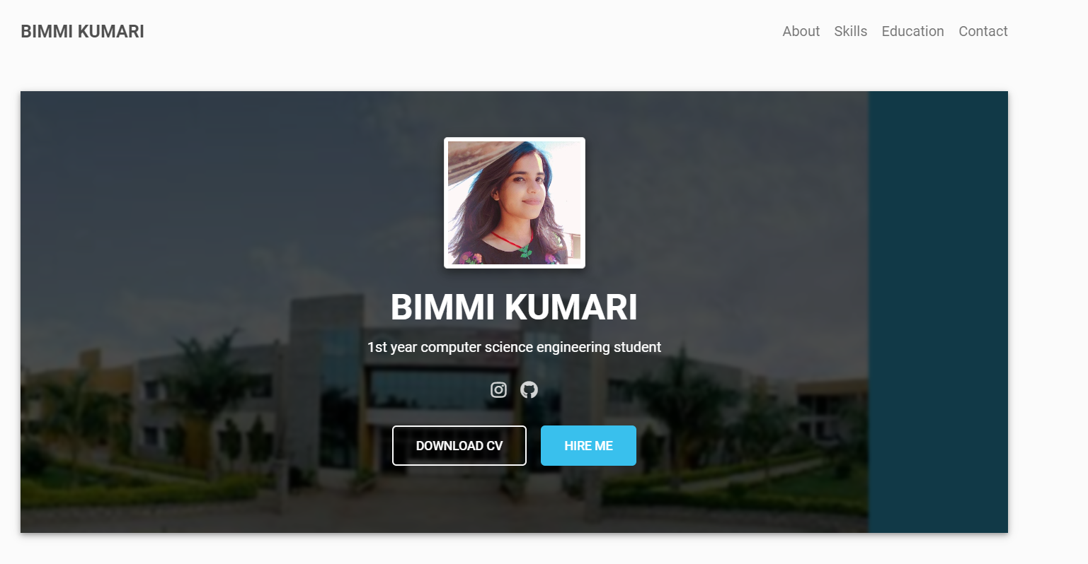
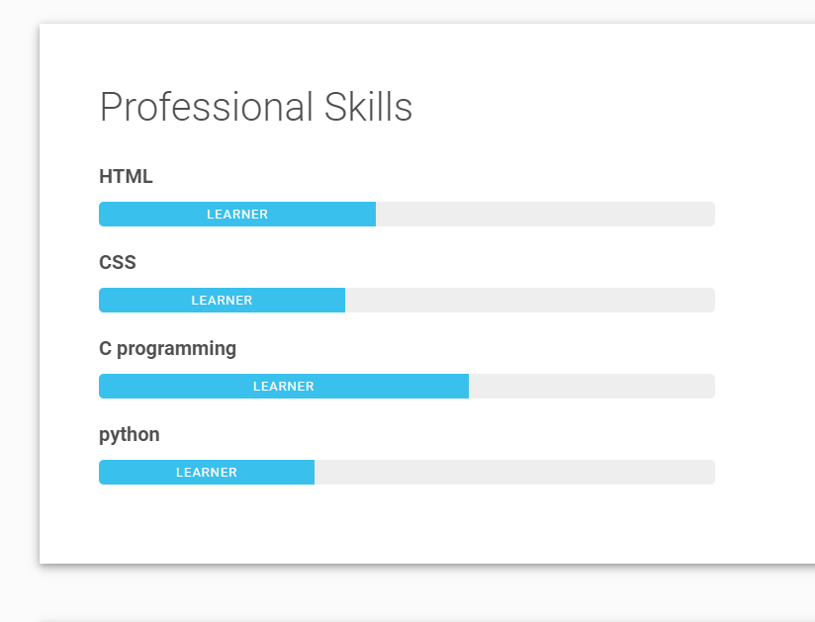
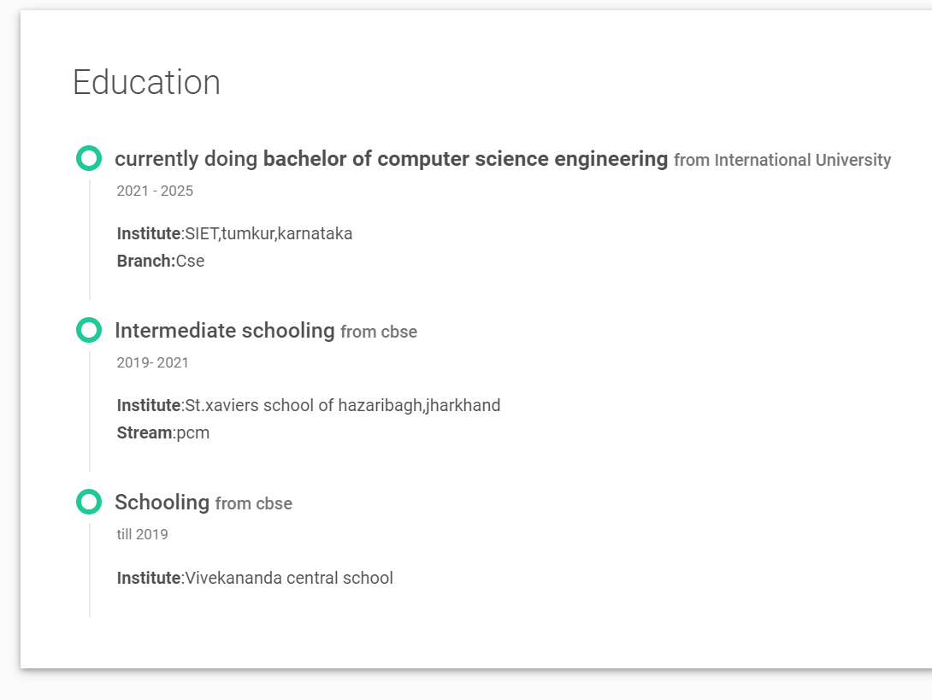
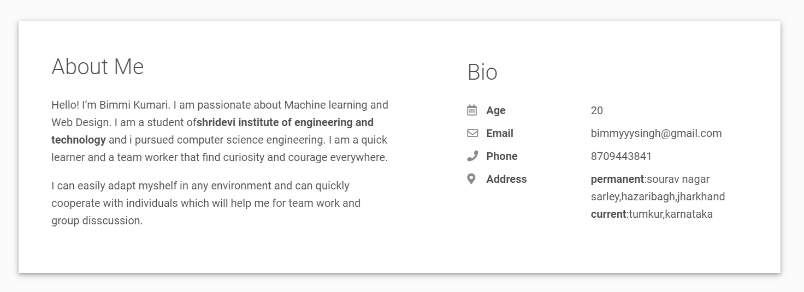
Project -1 : Project -1: Personal Website URL (Github)

Slide 4
Project -2 : Docker Image URL (DockerHub)
URL : https://hub.docker.com/r/bimmikumari/1sv21cs016_bimmikumari
Since docker is a registry sevice on the cloud which help us to download docker images which are build by other communities and it’s utilization helps to reduce the resources and things manageable and user friendly so going through docker hub project was actually exciting.
Here we created a docker image with image name having my usn and name and pushed it to docker hub.

Slide 5
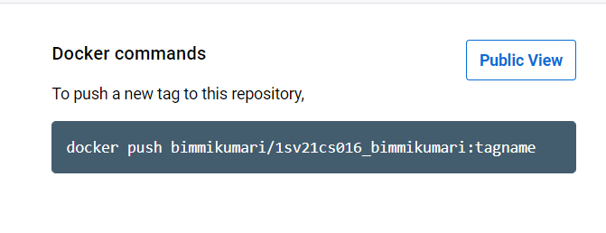
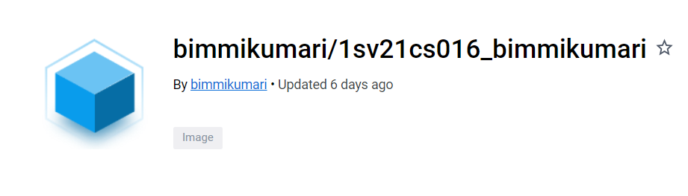
Project -2 : Docker Image URL (DockerHub)

Slide 6
Project -3 : Project -3: Data Science Project
Title : BIG MART SALES PREDICTION
Brief Description on Project:
The aim is to build a predictive model and find out the sales of each product at a particular store. Using this model, BigMart will try to understand the properties of products and stores which play a key role in increasing sales.

Slide 7
Project -3 : Project -3: Data Science Project
Project Flow:
Importing Libraries
Importing Data or loading data
Explorative Data Analysis:Univariate Analysis , Multi-variate Analysis , Bivariate Analysis
Finding Missing Values
columns Seperating
Train and test datause Machine Learning
Test Visualising Output
Evaluation or prediction of Sales

Slide 8
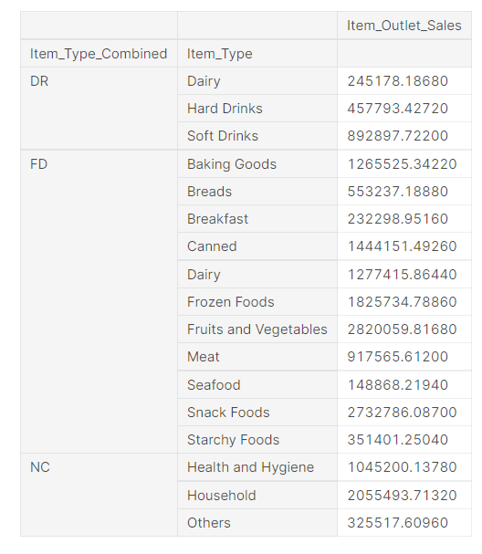
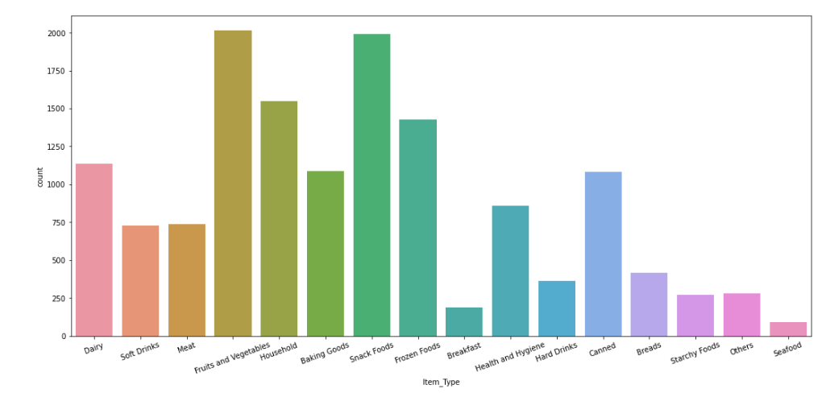
Project -3 : Project -3: Data Science Project

Slide 9
Skill-Set Obtained During the Internship
.Active listening:
Active listening is a communication skill that builds trust between you and your colleagues, and that empowers you to make informed decisions, resolve issues, and drive a team or organisation towards success
.Patience :
.Team work:
Collabrating problem solving leads to better outcome
.Communication:
Successful communication helps us better understand people and situations
. It helps us overcome diversities, build trust and respect, and create conditions
for sharing creative ideas and solving problems
It helps to reclaim and respond to the life with a firmly grouded sense of who we are.

Slide 10
Post Internship Plans on Projects :
I decided to work upon my first project that is github application utilization being an student of computer science it will provide me a great exposure to the remote collbration for people around world also it make it easy to dump any kind code and workpiece on a private repository .Also if we want other people to work upon our project they simply can contribute.It helps in easily branching and merging hence multiple peole can contribute and it will kill the communication gap.
So I am thinking to dump all the small codes I m going to learn in next coming days so that I can reach to my online reference anytime anywhere.

Slide 11
Interested to Join Students Club in SIET ? If yes ? Why Yes, I am interested to join the Student Club in SIET because being a part of a club will contribute in growth of communication skill, experience in leadership, and various soft skills, problem-solving, group discussion and management, presentation and enhancement of one’s personality.It's also the best way to expand my netwrok.

Slide 12
About ShriTEK Internship Programme: It helped me to explore various emerging field of technology and exposure to what actually virtual world demands. Like github ,docker and role of a data scientist. Also shritek innovations authority were reallly so interactive with each and every individual which helped all to grow together fluently.

Slide 13
Internship project feedback
Thank you

